Slide 1
Wind and Fisheries
24/6/19

Slide 2
Onshore winds
Adjusted to coastline angle
Using FRDC age compositions

Slide 3
Luderick (4 year lag north, 5 year lag south)

Slide 4
Luderick (4 year lag north, 5 year lag south)

Slide 5
Whiting (5 year lag north, 6 year lag south)

Slide 6
Whiting (5 year lag north, 6 year lag south)

Slide 7
Mullet (2 year lag)

Slide 8
Mullet (2 year lag)

Slide 9
Bream (7 year lag)

Slide 10
Bream (7 year lag)

Slide 11
Dusky flathead (3 year lag)

Slide 12
Dusky flathead (3 year lag)

Slide 13
45 degree angled winds
To test for upwelling

Slide 14
Luderick (4 year lag north, 5 year lag south)

Slide 15
Luderick (4 year lag north, 5 year lag south)

Slide 16
Whiting (5 year lag north, 6 year lag south)

Slide 17
Whiting (5 year lag north, 6 year lag south)

Slide 18
Mullet (2 year lag)

Slide 19
Mullet (2 year lag)

Slide 20
Bream (7 year lag)

Slide 21
Bream (7 year lag)

Slide 22
Dusky flathead (3 year lag)

Slide 23
Dusky flathead (3 year lag)

Slide 24
135 (SE) degree angled winds
To test for retention

Slide 25
Luderick (4 year lag north, 5 year lag south)

Slide 26
Luderick (4 year lag north, 5 year lag south)

Slide 27
Whiting (5 year lag north, 6 year lag south)

Slide 28
Whiting (5 year lag north, 6 year lag south)

Slide 29
Mullet (2 year lag)

Slide 30
Mullet (2 year lag)

Slide 31
Bream (7 year lag)

Slide 32
Bream (7 year lag)

Slide 33
Dusky flathead (3 year lag)

Slide 34
Dusky flathead (3 year lag)

Slide 35
Current Wind Speed
To investigate catchability
Axis labels should be mean wind speed (km⁻²)

Slide 36
Luderick

Slide 37
Luderick

Slide 38
Whiting

Slide 39
Whiting

Slide 40
Mullet

Slide 41
Mullet

Slide 42
Bream

Slide 43
Bream (7 year lag)

Slide 44
Dusky flathead

Slide 45
Dusky flathead

Slide 46
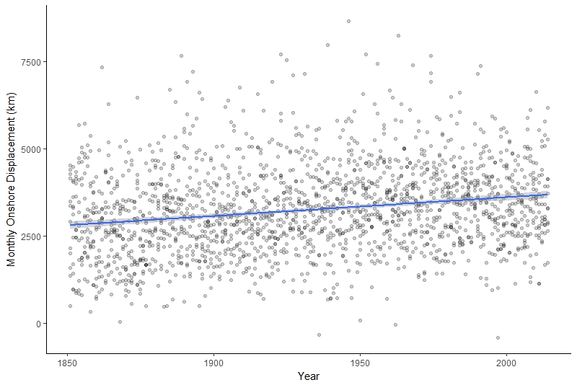
Increase in onshore winds over time @ Sydney

